Slide 1
Programs and software for conducting phase I trials
Graham Wheeler
Cancer Research UK & UCL Cancer Trials Centre
University College London
(with thanks to Philip Pallmann, Cardiff University)

Slide 2
R packages - https://cran.r-project.org/
Web applications
Software libraries
Commercial software

Slide 3
CRM
One-stage one-parameter CRM design
crm(…) – recommendation for single trial
crmsim(…) – for simulating many trials
crmsiminc1(…) – CRM (1 pts incomplete)
crmsiminc2(…) – CRM (2 pts incomplete)
Mo, 2012

Slide 4
install.packages("CRM")
library(CRM)
skeleton <- c(0.05, 0.10, 0.20, 0.35, 0.50, 0.70)
x <- c(3, 4, 4, 3, 3, 4, 3, 2, 2, 2)
y <- c(0, 0, 1, 0, 0, 1, 1, 0, 0, 0)
data <- cbind(x, y)
TTL <- 0.20
crm(target = TTL, prior = skeleton, ptdata = data, model = 1, a0 = 1)
$MTD
[1] 3
$a
[1] 0.8686574

Slide 5
truth <- c(0.10, 0.15, 0.20, 0.40, 0.50, 0.80)
crmsim(target = TTL, prior = skeleton, true = truth, rate = 2/28, cycle = 28, cohort = 1, nsubject = 24, nsim = 100, model = 2, a0 = 1, jump = FALSE, start.dose = 1, seed = 123)
$SimResult 1 2 3 4 5 6
% Selection 9.00 22.00 53.00 15.00 1.00 0.00
% Subjects Treated 16.46 19.92 36.79 19.21 6.29 1.33
# Subjects Treated 3.95 4.78 8.83 4.61 1.51 0.32
Average Toxicities 0.39 0.64 1.59 1.87 0.75 0.25
True probabilities 0.10 0.15 0.20 0.40 0.50 0.80
$TrialDuration
Min. 1st Qu. Median Mean 3rd Qu. Max.
541.0 592.8 612.0 612.6 632.0 693.0

Slide 6
dfcrm
Package for CRM and TITE-CRM conduct/simulation
crm(…) & titecrm(…) – conduct single trial
crmsim(…) & titesim(…) – simulate many trials
Cheung, 2011; Cheung and Duong, 2013

Slide 7
install.packages("dfcrm")
library(dfcrm)
prior <- c(0.05, 0.10, 0.20, 0.35, 0.50, 0.70)
x <- c(3, 4, 4, 3, 3, 4, 3, 2, 2, 2)
y <- c(0, 0, 1, 0, 0, 1, 1, 0, 0, 0)
crm(prior = prior, target = 0.20, tox = y, level = x)
[summary of data given here]
Toxicity probability update (with 90 percent probability interval):
Level Prior n total.wts total.tox Ptox LoLmt UpLmt 1 0.05 0 0 0 0.089 0.01 0.283 2 0.1 3 3 0 0.155 0.028 0.379 3 0.2 4 4 1 0.272 0.082 0.508 4 0.35 3 3 2 0.428 0.196 0.643 5 0.5 0 0 0 0.571 0.341 0.747 6 0.7 0 0 0 0.749 0.574 0.861 Next recommended dose level: 2 Recommendation is based on a target toxicity probability of 0.2
Estimation details: Empiric dose-toxicity model: p = dose^{exp(beta)} dose = 0.05 0.1 0.2 0.35 0.5 0.7 Normal prior on beta with mean 0 and variance 1.34 Posterior mean of beta: -0.212 Posterior variance of beta: 0.158

Slide 8
t <- 180 entry <- c( 7, 29, 49, 76, 92, 133, 241, 303, 363, 402) exit <- c(185, 210, 217, 257, 116, 314, 420, 405, 405, 405)
trial <- titecrm(prior = prior, target = 0.20, tox = y, level = x, obswin = t, entry = entry, exit = exit)
> trial
[summary of data and weightings given here]
Toxicity probability update (with 90 percent probability interval):
Level Prior n total.wts total.tox Ptox LoLmt UpLmt
1 0.05 0 0 0 0.162 0.016 0.448
2 0.1 3 0.817 0 0.247 0.042 0.54
3 0.2 4 3.122 1 0.377 0.11 0.65
4 0.35 3 3 2 0.529 0.236 0.755
5 0.5 0 0 0 0.657 0.386 0.831
6 0.7 0 0 0 0.805 0.613 0.909
Next recommended dose level: 1
Recommendation is based on a target toxicity probability of 0.2
Estimation details:
Empiric dose-toxicity model: p = dose^{exp(beta)}
dose = 0.05 0.1 0.2 0.35 0.5 0.7
Normal prior on beta with mean 0 and variance 1.34
Posterior mean of beta: -0.5
Posterior variance of beta: 0.247

Slide 9
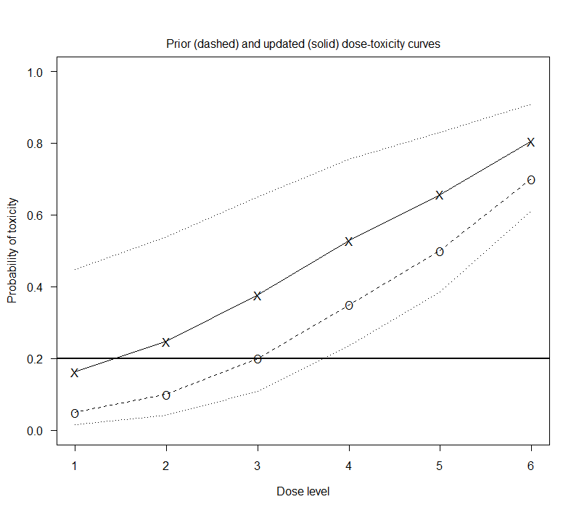
> plot(trial, ask = TRUE)

Slide 10
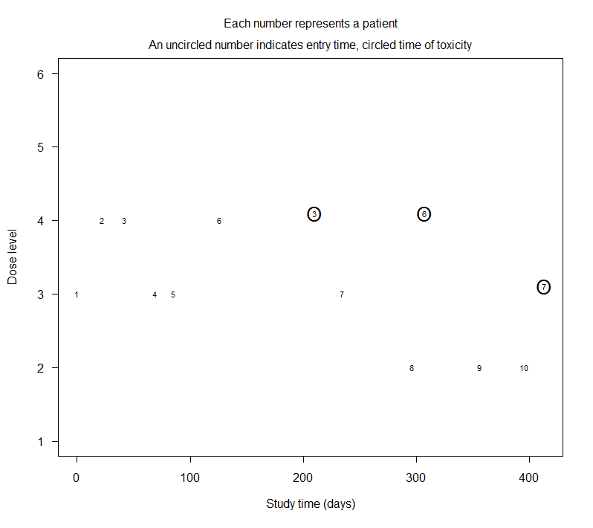
> plot(trial, ask = TRUE)

Slide 11
bcrm
Bayesian one-stage CRM designs, inc. CRM and EWOC
bcrm(…) – conduct single trial or simulate many
New release due soon (but still available!)
Sweeting et al, 2013

Slide 12
install.packages("bcrm")
library(bcrm)
dose <- c(0.5, 1, 3, 5, 6)
prior.p <- c(0.05, 0.15, 0.25, 0.35, 0.45)
true.p <- c(0.01, 0.05, 0.15, 0.25, 0.40)
trial <- bcrm(stop = list(nmax = 24, nmtd = 8), p.tox0 = prior.p, dose = dose, truep = true.p, ff = "power", prior.alpha = list(3, 0, 1.34), target.tox = 0.25, cohort = 2, start = 1, pointest = "plugin", sdose.calculate = "median", constrain = TRUE, simulate = TRUE, nsims = 100, threep3 = TRUE, quietly = TRUE)
> trial
Operating characteristics based on 100 simulations:
Mean Minimum Maximum Sample size 18.26 10 24
Doses 0.5 1 3 5 6 Experimentation proportion 0.12 0.146 0.243 0.252 0.239 Recommendation proportion 0.00 0.010 0.230 0.420 0.340
Probability of DLT [0,0.2] (0.2,0.4] (0.4,0.6] (0.6,0.8] (0.8,1] Experimentation proportion 0.495 0.505 0 0 0 Recommendation proportion 0.240 0.760 0 0 0

Slide 13
> trial[[1]]$threep3
Mean Minimum Maximum
Sample size 17.86194 3 30
Doses
< 1 1 2 3 4 5
Experimentation proportion NA 0.1870 0.233 0.266 0.213 0.101
Recommendation proportion 0.00118 0.0278 0.196 0.336 0.292 0.147
Probability of DLT
[0,0.2] (0.2,0.4] (0.4,0.6] (0.6,0.8] (0.8,1]
Experimentation proportion 0.686 0.314 0 0 0
Recommendation proportion* 0.560 0.439 0 0 0
* Amongst those trials that recommend an MTD
Doses
1 2 3 4 5
Average number of patients 3.1700 3.920 4.66 4.07 2.040
Average number of DLTs 0.0317 0.196 0.70 1.02 0.816

Slide 14
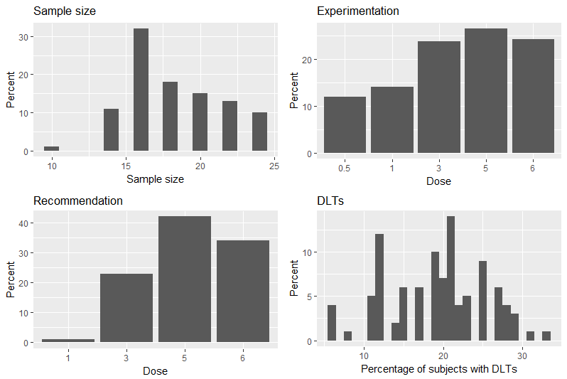
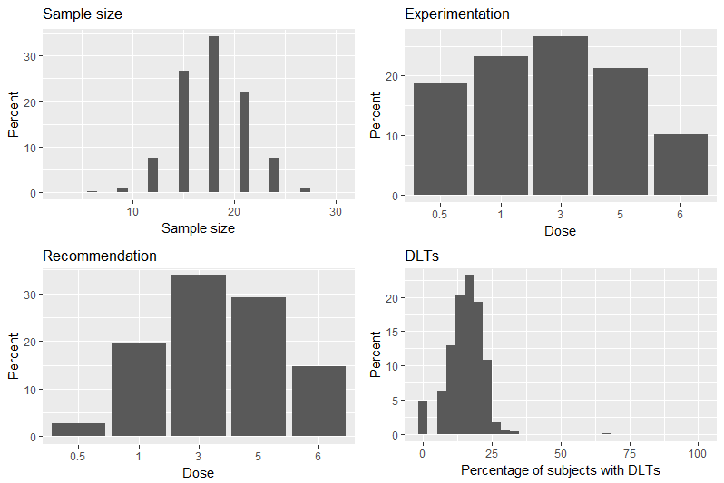
> plot(trial) > plot(trial[[1]]$threep3)

Slide 15
pocrm
2 4 6
1 3 5
Drug B
Drug A
Partial-order CRM applied to dual-agent trials
getwm(…) – working models (skeletons) for partial orders
pocrm.imp(…) – for estimation in a single trial
pocrm.sim(…) – for simulating many trials
Wages et al, 2013; Wages and Varhegyi, 2013

Slide 16
install.packages("pocrm")
library(pocrm)
orders<-matrix(c(1, 2, 3, 4, 5, 6,
1, 2, 3, 5, 4, 6,
1, 3, 2, 4, 5, 6,
1, 3, 5, 2, 4, 6,
1, 3, 2, 5, 4, 6), nrow = 5, ncol = 6, byrow = TRUE)
skeleton <- c(0.01, 0.05, 0.10, 0.20, 0.25, 0.40)
alpha <- getwm(orders, skeleton)
x <- c(1, 3, 5, 2, 4, 3, 3, 2, 4)
Y <- c(0, 0, 1, 0, 1, 0, 0, 0, 0)
trial<-pocrm.imp(alpha = alpha, prior.o = rep(1/5, 5), theta = 0.25, y = y, combos = x)
> trial
$ord.prob [1] 0.225 0.207 0.245 0.098 0.225
$order.est [1] 3
2 4 6
1 3 5
$a.est [1] 0.739
$ptox.est [1] 0.033 0.183 0.109 0.305 0.359 0.508
$dose.rec [1] 4
Drug B
Drug A

Slide 17
x0 <- c(1, 2, 3, 5, 4, 6)
n <- 20
nsim <- 100
tox.range <- 0.05
stop <- 10
r <- c(0.05, 0.10, 0.20, 0.25, 0.40, 0.60)
trial <- pocrm.sim(r = r, alpha=alpha, prior.o = rep(1/5, 5), theta = 0.25, x0 = x0, stop = stop, n = n, nsim = nsim, tox.range = tox.range)
> trial
$true.prob [1] 0.05 0.10 0.20 0.25 0.40 0.60
$MTD.selection [1] 0.01 0.18 0.28 0.30 0.20 0.03
$patient.allocation [1] 0.11 0.23 0.24 0.20 0.18 0.05
2 4 6
1 3 5
Drug B
Drug A
$percent.DLT [1] 0.2356589
$mean.n
[1] 19.35
$acceptable
[1] 0.58

Slide 18
… and many others!
ewoc – for EWOC
dfpk – use PK data and DLT to inform escalation
crmPack – versatile package for model-based designs
dfcomb – designs for combination trials
ordcrm – ordinal CRM (toxicity grades rather than DLT yes/no)
Diniz, 2017
Tournazi et al, 2017
Sabanés-Bové et al, 2017
Riviere and Jordan, 2017
Dressler and Huang, 2016

Slide 19
“crm” – Stata module for implementing CRM (Adrian Mander, MRC Biostatistics Unit, Cambridge) https://ideas.repec.org/c/boc/bocode/s457625a.html
Naoki Ishizuka has written SAS code for the CRM: http://www.lexjansen.com/pharmasug/2001/Proceed/Stats/SP13_ishizuka.pdf
TITE-CRM Phase I Clinical Trials: Implementation Using SAS (University of Michigan) https://sph.umich.edu/ccb/pdf/titecrm_manual_1-5-09.pdf

Slide 20
Web Applications
A+B designs: https://graham-wheeler.shinyapps.io/AplusB/
Optimal benchmark for comparison: https://uvatrapps.shinyapps.io/nonparbnch/
Bayesian CRM: https://uvatrapps.shinyapps.io/crmb/
Vanderbilt University Software Library: https://www.vumc.org/cqs/software-tools
Wheeler et al, 2016

Slide 21
https://biostatistics.mdanderson.org/softwaredownload/

Slide 22
Standalone programs
Easy to use
May not have all options you want
Some packages updated more often than others

Slide 23
Phase I & Phase II support
Single- & dual-agent designs
Rule- and model-based
Phase I and Phase II designs
Single- and multi-stage
Flexible approach to CRM
Primarily geared towards MCPMod (Multiple Comparison Procedure – Modelling) [dose-response]
CRM, EWOC, mTPI, and rule-based designs

Slide 24
Summary
Many packages and programs available
Most are free!
Experience with R (even limited) is a bonus
Allows you to explore new releases and even edit code to specific trial needs
Web applications and standalone programs for those less familiar with code (with code available in most cases)

Slide 25
References
Cheung YK (2011): Dose-finding by the Continual Reassessment Method. CRC Press/Chapman & Hall. Boca Raton.
Cheung YK and Duong J (2013): “dfcrm” package. CRAN. https://cran.r-project.org/web/packages/dfcrm/dfcrm.pdf
Diniz MA (2017): “ewoc” package. CRAN. https://cran.r-project.org/web/packages/ewoc/ewoc.pdf
Dressler EV and Huang Z (2016): “ordcrm” package. CRAN. https://cran.r-project.org/web/packages/ordcrm/ordcrm.pdf
Mo, Q (2012): “CRM” package. CRAN. https://cran.r-project.org/web/packages/CRM/CRM.pdf
Sabanés-Bové D, Yeung WY, Palermo G and Jaki T (2017): “crmPack” package. CRAN. https://cran.r-project.org/web/packages/crmPack/crmPack.pdf
Riviere M and Jourdan J (2017): “dfcomb” package. CRAN. https://cran.r-project.org/web/packages/dfcomb/dfcomb.pdf
Sweeting MJ, Mander AP and Sabin T (2013): bcrm: Bayesian Continual Reassessment Method designs for phase I dose-finding trials. Journal of Statistical Software 54(13):1-26.
Tournazi A, Ursino M and Zohar S (2017): “dfpk” package. CRAN. https://cran.r-project.org/web/packages/dfpk/dfpk.pdf
Wages NA, Conaway M and O’Quigley J (2011). Dose-finding design for multi-drug combinations. Clinical Trials 8(4):380-9.
Wages NA and Varhegyi N (2013); pocrm: An R-package for phase I trials of combinations of agents. Computer Methods and Programs in Biomedicine 112(1):211-8.
Wheeler GM, Sweeting MJ and Mander AP (2016): AplusB: A web application for investigating A+B designs for phase I cancer clinical trials. PLoS ONE 11(7):e0159026.

